Slide 1
Amazon EC 2 Instance
Amazon EC 2 Instance
User’s Computer
Mongo DB
Java Servlet
User Facing Web Page
Mongo.jar
JSP/Tomcat
Notes:
Overall diagram

Slide 2
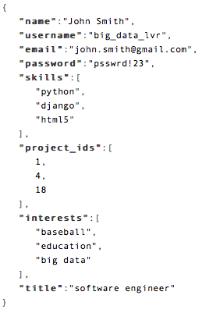

Slide 3
